Slide 1
Jenkins with Groovy Script
-Manne Niteesh Chandra

Slide 2
Prerequistie
Introduction
Sample Groovy Script
Working

Slide 3
Introduction
Git:
Git is a version control system.
Git helps you keep track of code changes.
Git is used to collaborate on code.
Jenkins:
Jenkins is a tool that is used for automation, and it is an open-source server that allows all the developers to build, test and deploy software. It works or runs on java as it is written in java. By using Jenkins we can make a continuous integration of projects(jobs) or end-to-endpoint automation.

Slide 4
Docker:
Docker is an open source platform that enables developers to build, deploy, run, update and manage containers—standardized, executable components that combine application source code with the operating system (OS) libraries and dependencies required to run that code in any environment.

Slide 5
Groovy Script:
Jenkins features a Groovy script console which allows one to run arbitrary Groovy scripts within the Jenkins controller runtime or in the runtime on agents.

Slide 6
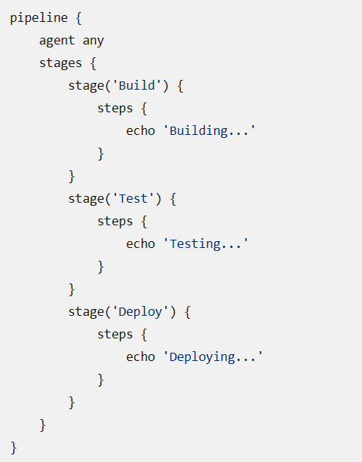
Sample Groovy Script

Slide 7
Working:
Create an EC2 instance
Install required software (Jenkins,docker,git)
Open Jenkins in browser
Try building a job with github project
Then click on create a job with pipeline option
Assign the project Github Url
Then type the reruired Groovy Script
Then the pipeline is created using Groovy Script.

Slide 8
Thank You

